Slide 1
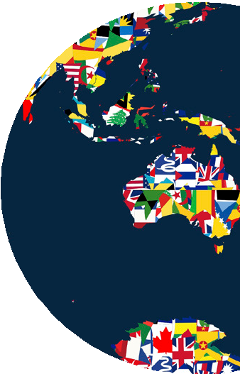
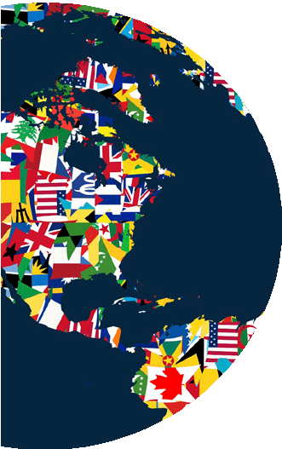
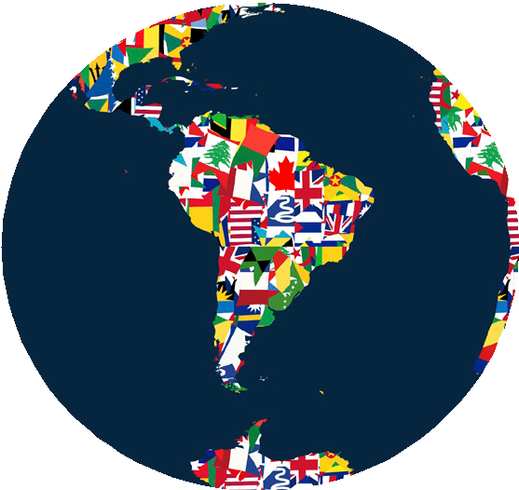
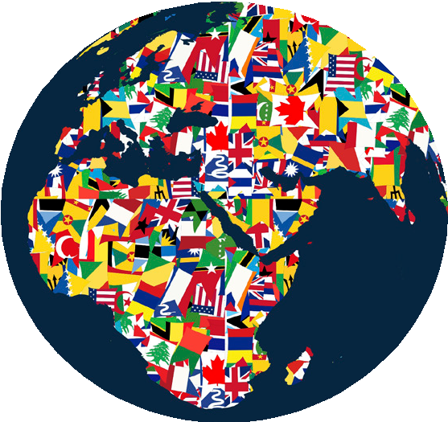
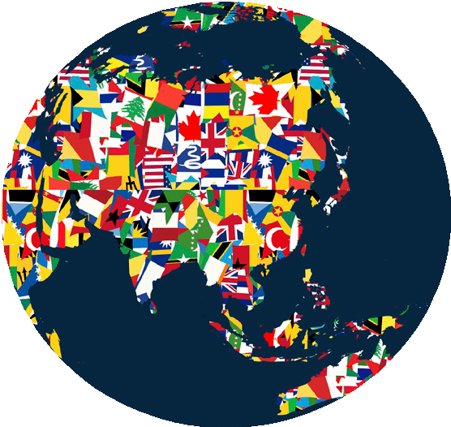
Working Across Cultures
and Knowing When to Shut Up
Erin Meyer

Slide 2
Today, we are all part of a global network (real or virtual, physical or electronic) where success requires navigating through wildly different cultural realities.
Notes:
Unless we know how to decode other cultures and avoid easy-to-fall-into cultural traps, we are easy prey to misunderstanding, needless conflict, and deals that fall apart.
Yet most managers have little understanding of how local culture impacts global interaction. Even those who are culturally informed, travel extensively, and have lived abroad often have few strategies for dealing with the cross-cultural complexity that affects their team’s day-to-day effectiveness. Often the cross-cultural challenges that arise could be avoided by learning a few basic principles. For example, the answer to the simple question, “When should I speak and when should I be quiet?” varies dramatically from one culture to another.

Slide 3
“When should I speak and
when should I be quiet?”
Notes:
Often the cross-cultural challenges that arise could be avoided by learning a few basic principles. For example, the answer to the simple question, “When should I speak and when should I be quiet?” varies dramatically from one culture to another.

Slide 4
The Eight Scales on the
Culture Map
Communication
Evaluation
Persuading
Leading
Deciding
Trusting
Disagreeing
Scheduling

Slide 5
Communication
Low context
Precise
Explicit
Face value
High context
Layered
Implied
Silence
Notes:
Communicating. When we say that someone is a good communicator, what do we actually mean? The responses differ wildly from society to society. Cultures can be compared by measuring the degree to which they are high-context or low-context.
In low-context cultures, good communication is precise, simple, explicit, and clear. Messages are understood at face value.
Repetition is appreciated for purposes of clarification, as is putting messages in writing.
In high- context cultures, communication is sophisticated, nuanced, and layered.
Messages are often implied but not plainly stated.
Less is put in writing, more is left open to interpretation, and understanding may depend on reading between the lines.
Silence in itself may pass specific meanings, and an effective communicator is able to read the silence in order to manage the interaction effectively. In
low-context cultures, communication requires less reading between the lines. If you have some- thing to say, it would be expected that you would state clearly “I have something to add.”

Slide 6
Evaluation
Direct
Precise
Explicit
Direct
Indirect
Layered
Implied
Diplomatic
Notes:
All cultures believe criticism should be given constructively, but the definition of “constructive” varies greatly. This scale measures a preference for frank versus diplomatic negative feedback. Evaluating is often confused with Communicating, but many countries have different positions on the two scales. The French, for example, are high-context (implicit) communicators relative to Americans, yet they are more direct in their criticism. Spaniards and Mexicans are both high-context cultures, but the Spanish are much more frank when providing negative feedback.

Slide 7
Leading
Egalitarian
Precise
Explicit
Face value
Hierarchical
Layered
Implied
Silence
Notes:
This scale measures the degree of respect and deference shown to authority figures, placing countries on a spectrum from egalitarian to hierarchical. The Leading scale is based partly on the concept of power distance, first researched by the Dutch social psychologist GeertHofstede, who conducted 100,000 management surveys at IBM in the 1970s. It also draws on the work of management professors Robert House and his colleagues in their GLOBE (global leadership and organizational behavior effectiveness) study of 62 societies.

Slide 8
Deciding
Consensual decisions
vs
Top-down decisions
Notes:
This scale measures the degree to which a culture is consensus-minded. We often assume that the most egalitarian cultures will also be the most democratic, while the most hierarchical ones will allow the boss to make unilateral decisions. This isn’t always the case.
Germans are more hierarchical than Americans, but more likely than their U.S. colleagues
to build group agreement before making decisions. The Japanese are both strongly hierarchical and strongly consensual.

Slide 9
Trusting
Cognitive
Collaborative
Reliable
Respectful
Affective
Personal
Socializing
Mutual liking
Notes:
Cognitive trust (from the head) can be contrasted with affective trust (from the heart).
In task-based cultures, trust is built cognitively through work. If we collaborate well, prove our- selves reliable, and respect each other’s contributions, we come to trust each other.
In a relationship-based society, trust is a result of weaving a strong affective connection. If we spend time laughing and relaxing together, get to know each other at a personal level, and feel a mutual liking, and then come to trust each other.

Slide 10
Disagreeing
High conflict
Precise
Explicit
Face value
Low conflict
Layered
Implied
Silence
Notes:
Everyone believes a little open disagreement is healthy, right? The recent American business literature certainly confirms this viewpoint. But different cultures actually have very different ideas about how productive confrontation is for a team or organization. This scale measures tolerance for open disagreement, and views on whether it is likely to improve or destroy collegial relationships.

Slide 11
Scheduling
Linear
Structured
Strict scheduling
Flexible
Reactive
Layered
Notes:
All businesses follow agendas and timetables, but in some cultures people strictly adhere to the schedule, while in other cultures, people treat it as a suggestion. This scale assesses how much value is placed on operating in a structured, linear fashion versus being flexible and reactive.

Slide 12
Persuading
Holistic
Pieces of the whole
Applications first
Specific
Distinct components
Principles first
Notes:
The ways in which you persuade others, and the kinds of arguments you find convincing, are deeply rooted in your culture’s philosophical, religious, and educational assumptions and attitudes. The traditional way to compare countries along this scale is to assess how they balance holistic and specific thought patterns. Typically, a western executive will break an argument down into a sequence of distinct components (specific thinking), while Asian managers tend to show how each component fits with all the others (holistic thinking). Beyond that, people from southern European and Germanic cultures tend to find deductive arguments (what I refer
to as principles-first arguments) most persuasive, whereas American and British managers are more likely influenced by inductive logic (what I call applications-first logic).

Slide 13
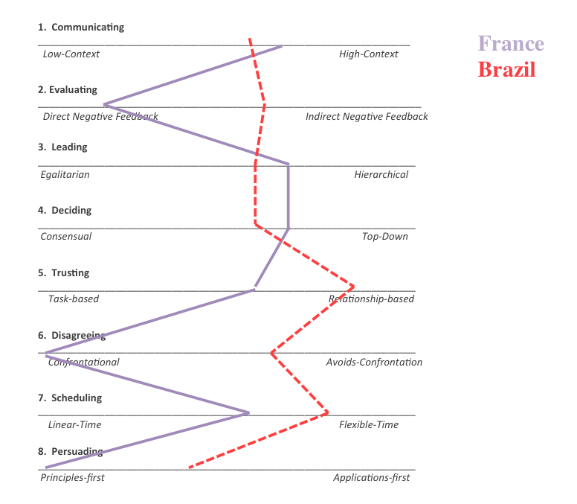
Notes:
For a second example here is a culture map of French culture plotted against Brazilian culture. These two cultures are similar on the Communicating and Deciding scales, yet far apart on the Disagreeing scales.

Slide 14
Notes:
For example, here is a Culture Map of the American culture plotted against Japanese culture. Notice how the US and Japan are quite far apart on the Communicating and Persuading scales, yet quite close together on the Scheduling scale.

Slide 15
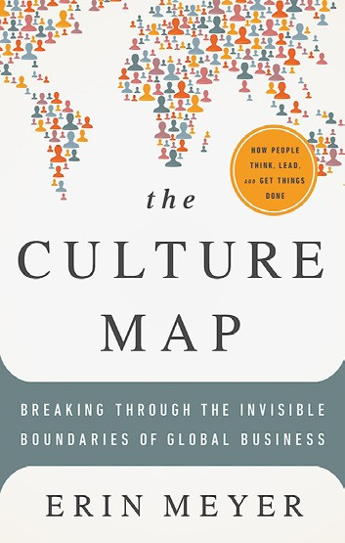
Info
BUY THE BOOK | Get more details or buy a copy of The Culture Map.
ABOUT THE AUTHOR | Erin Meyer is a professor at INSEAD, one of the world’s leading international business schools. Her work focuses on how the world’s most successful global leaders navigate the complexities of cultural differences in a multicultural environment.
Living and working in Africa, Europe, and the United States prompted Meyer’s study of the communication patterns and business systems of different parts of the world. Her framework allows international executives to pinpoint their leadership preferences, and compare their methods to the management styles of other cultures. Her work has appeared in Harvard Business Review, Singapore Business Times, and on Forbes.com. In 2013 Erin was selected
by the Thinkers50 Radar list as one of the world’s up-and-coming business thinkers.
SEND THIS | Pass along a copy of this manifesto to others.
SUBSCRIBE | Sign up for e-news to learn when our latest manifestos are available.
This document was created on September 24, 2014 and is based on the best information available at that time. The copyright of this work belongs to the author, who is solely responsible for the content. This work is licensed under the Creative Commons Attribution-NonCommercial-NoDerivs License. To view a copy of this license, visit
Creative Commons or send a letter to Creative Commons, 559 Nathan Abbott Way, Stanford, California 94305, USA. Cover image from Veer. You are given the unlimited right to print this manifesto and to distribute it electronically (via email, your website, or any other means). You can print out pages and put them in your favorite coffee shop’s
windows or your doctor’s waiting room. You can transcribe the author’s words onto the sidewalk, or you can hand out copies to everyone you meet. You may not alter this manifesto in any way, though, and you may not charge for it.

